Slide 1

SNA using R 2 – DPLYR
March 2019 – CDPH
Esther.Kukielka@CDPH.ca.gov
This workshop heavily borrows from the list of references provided at the end of the presentation

Slide 2
Learning objectives
Working directory
Load external data from a .csv file into a data frame
Packages and libraries
Get familiar with tidyverse and dplyr
select()
filter()
Pipe %>%
mutate()
arrange()
Split-and-apply:
summarize ()
group_by()
count()
Wide and long data
spread()
gather()
Export a data frame to a .csv file
What is a network

Slide 3
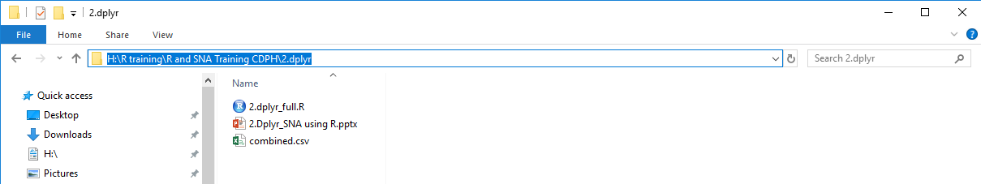
Working directory
Where your files live
Must be set up every R session (when using our data)
How to get it?
My way:
Alternative ways:
a) Use RStudio’s Files pane to navigate to a directory and then set it as working directory from the menu: Session –> Set Working Directory –> To Files Pane Location
b) Within the Files pane, choose More and Set As Working Directory

Slide 4
Chunk 1
https://datacarpentry.org/R-ecology-lesson/03-dplyr.html

Slide 5
What is a network
Nodes (or vertices)
H
H
H
H
H
H
HC Facility
H
Notes:
Individual:
Age
Breed
Reproductive stage …
Groups:
Size of farm/village/group
Mixed species
Years operational
Type of production system
Staff (seasonal/permanent, working in other farms, etc)…

Slide 6
What is a network
Edges (or links)
H
H
H
H
H
H
HC Facility
H
Transaction
Notes:
Individual:
Age
Breed
Reproductive stage …
Groups:
Size of farm/village/group
Mixed species
Years operational
Type of production system
Staff (seasonal/permanent, working in other farms, etc)…

Slide 7
What is a network
Directionality
H
H
H
H
H
H
HC Facility
H
Transaction
Notes:
Individual:
Age
Breed
Reproductive stage …
Groups:
Size of farm/village/group
Mixed species
Years operational
Type of production system
Staff (seasonal/permanent, working in other farms, etc)…

Slide 8
What is a network
Edge attributes
H
H
H
H
H
H
HC Facility
H
Transaction
Notes:
Individual:
Age
Breed
Reproductive stage …
Groups:
Size of farm/village/group
Mixed species
Years operational
Type of production system
Staff (seasonal/permanent, working in other farms, etc)…

Slide 9
What is a network
Node attributes
H
H
H
H
H
H
H
HC Facility
H
Transaction
Notes:
Individual:
Age
Breed
Reproductive stage …
Groups:
Size of farm/village/group
Mixed species
Years operational
Type of production system
Staff (seasonal/permanent, working in other farms, etc)…

Slide 10

What is a network
H
Acute Care Hospital
Node attributes
H
H
Skilled Nursing Facility
H
Community Clinic
H
H
H
H
H
H
HC Facility
H
Interpretation? Implications?
Transaction
Notes:
Individual:
Age
Breed
Reproductive stage …
Groups:
Size of farm/village/group
Mixed species
Years operational
Type of production system
Staff (seasonal/permanent, working in other farms, etc)…

Slide 11
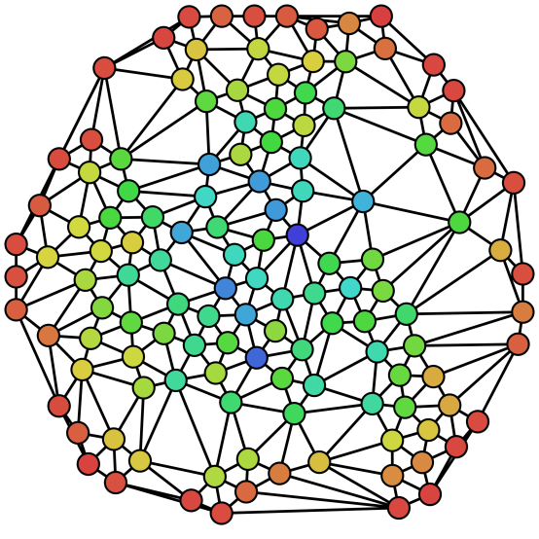
What is Social network useful for?
Identification of hubs (i.e., important facilities regarding transfers)
Disease spread ➔ Control strategies
Disease introduction ➔ Prevention strategies
➔ Targeted and cost-effective interventions
Risk factor analysis (i.e. regression)
Outbreak investigation (i.e., traceability)

Slide 12
Nodes
part_names | ID | latitude | longitude | premise_type | scale | area
Phraya Market | 5013 | 101.4824 | 13.74333 | market | market | North
Aaron | 4551 | 103.262 | 16.86244 | farm | industrial | North
Dylan | 5352 | 99.40534 | 8.105594 | farm | backyard | South
Monique | 9267 | 101.6115 | 15.50182 | farm | industrial | North
Nicole | 8591 | 104.0598 | 16.4213 | farm | backyard | North
Aanisa | 5653 | 103.9717 | 18.061 | farm | industrial | North
Node attributes

Slide 13
Edges
Edges: How to measure contacts?
Between health care facilities:
National traceability
Hospital records
Between people:
Direct visual observation
Surveys
Global positioning System (GPS) devices

Slide 14
Edges
origin | dest | month | nb_pigs
Brandon | Aanisa | February | 106
Jacob | Aanisa | December | 83
Phraya Market | Aanisa | February | 25
Sabeeha | Aanisa | November | 96
Aaron | Aaron | September | 97
Jonah | Aaron | October | 81
Phraya Market | Aaron | January | 85
Edges attributes

Slide 15
part_names | ID | latitude | longitude | premise_type | scale | area
Phraya Market | 5013 | 101.4824 | 13.74333 | market | market | North
Aaron | 4551 | 103.262 | 16.86244 | farm | industrial | North
Dylan | 5352 | 99.40534 | 8.105594 | farm | backyard | South
Monique | 9267 | 101.6115 | 15.50182 | farm | industrial | North
Nicole | 8591 | 104.0598 | 16.4213 | farm | backyard | North
Aanisa | 5653 | 103.9717 | 18.061 | farm | industrial | North
origin | dest | month | nb_pigs
Brandon | Aanisa | February | 106
Jacob | Aanisa | December | 83
Phraya Market | Aanisa | February | 25
Sabeeha | Aanisa | November | 96
Aaron | Aaron | September | 97
Jonah | Aaron | October | 81
Phraya Market | Aaron | January | 85
latitude | longitude

Slide 16
Packages and libraries
Package: Compilation of functions, data and documentation
Must be installed once (Reinstall only when updating R/RStudio)
Need internet connection (downloads package from web)
R comes with a standard set of packages which libraries don’t need to be called (base R)
Library: Directory where packages are stored
Must be called at each R session (before using the functions it contains)

Slide 17
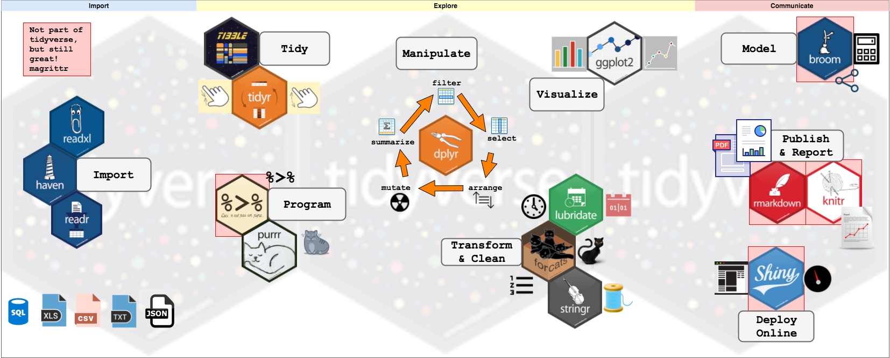
tidyverse
haven reads SPSS, Stata, and SAS files
Notes:
Approx. 20 different packages

Slide 18
tidyverse
Tidy data:
Each column is a variable
Each row is an observation
Each cell is a value
Takes one step at a time and connects simple steps through pipes (faster to write and to read)
Data frames are now tibbles!

Slide 19
Chunk 2

Slide 20
Basic dplyr functions (I)
select(): Choose column
filter(): Choose row
'pipe' operator %>%: Link the output of one dplyr function to the input of another function
mutate(): Create new columns
group_by() takes as arguments the column names that contain the categorical variables for which you want to calculate a summary statistic
summarize() collapses each group into a single-row summary of that group
count(): Number of observations found for each factor or combination of factors

Slide 21
Chunk 3
https://datacarpentry.org/R-ecology-lesson/03-dplyr.html

Slide 22

break

Slide 23
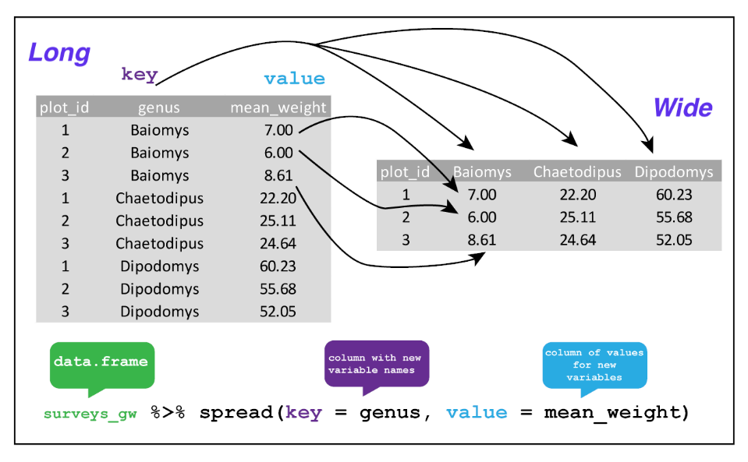
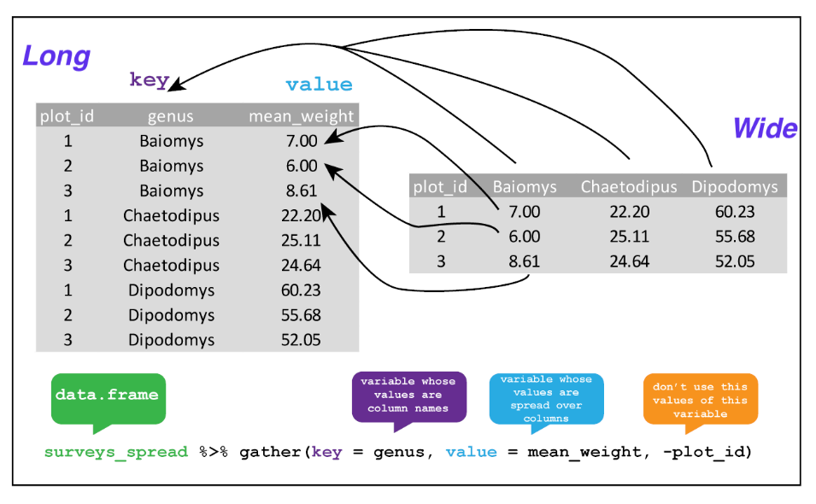
Basic dplyr functions (II)
spread() makes wide data (from long). Takes three arguments
the data
the key column variable whose values will become new column names
the value column variable whose values will fill the new column variables
gather() makes long format (form wide). Takes four arguments
the data
the key column variable we wish to create from column names.
the value column variable we wish to create and fill with values associated with the key.
the names of the columns we use to fill the key variable (or to drop)

Slide 24
Chunk 4*
https://datacarpentry.org/R-ecology-lesson/03-dplyr.html
* I will skip Chunk 4, but you have all documentation with you

Slide 25
Finally
NA and dplyr
Export a data frame to a .csv file
Quitting R
Summary of the workshop

Slide 26
Next time…
I will give a brief overview on networks (~15min) ➔ Done!
The rest of the day will be for you to work on your data!
Bring your own dataset with ideas on how you want to modify it
➔ You will work on it, I will be around if needed
If you don’t have a dataset, let me know asap

Slide 27
REsources and references
Tidyverse: https://rviews.rstudio.com/2017/06/08/what-is-the-tidyverse/
Data carpentry: https://datacarpentry.org/R-ecology-lesson
R for data science: https://r4ds.had.co.nz/index.html
Joining Data in R with dplyr: https://rpubs.com/williamsurles/293454
Guru 99
Differences between integer and double
Video from Mike Levy on tidyverse
Video from the creator of tidyverse
Dplyr more advanced functions http://www3.econ.muni.cz/~137451/files/dplyr.html

